Slide 1
Student Data Analysis
Exploratory insights using Excel Dashboard
By: Ruth Yakubu

Slide 2
Project Overview
This project explores student performance and lifestyle data using Excel. It highlights factors influencing academic outcomes such as parental education, study time, support programs, and gender differences.

Slide 3
Key Metrics Summary
Total number of students analyzed: 395
Key filters: Family size, School support, Gender, Age
Performance indicators: Final grades, study time, parental education level
Lifestyle metrics: Free time, going out, health scores, etc.

Slide 4
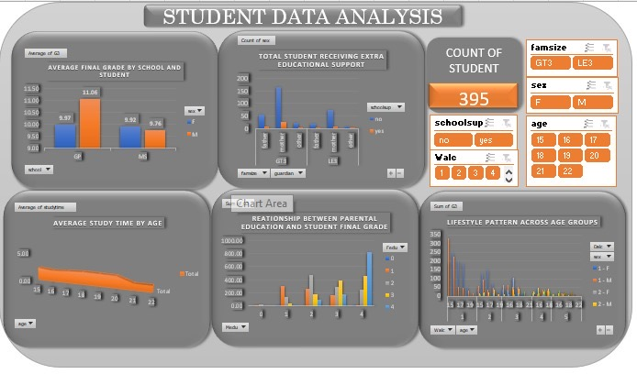

Slide 5
Key Insights -Performance Difference by School and Gender
Students from certain schools performed better on average.
Male students had higher average grades(11.06) than female students(9.97)
Average Final Grade is higher among males in certain schools.
Implication: Gender-specific academic intervention may be helpful.

Slide 6
Key Insights –Family Situation Influences Support Needs.
Students receiving extra support were tracked across school, family size, and gender.
More students without support compared to those with it.
Students receiving extra educational support showed mixed performance trends.
Performance of supported students varies- suggesting that quality of support matters more than access alone.

Slide 7
Key Insights –Groups Ages and Examines how Much they Study
Thers is a slight decline in study hours as age increases.
Younger students(15-17) study slightly more on average compared to older students (18-22).
Average study time decreases slightly with age.

Slide 8
Key Insights –How Average Grades relates to Parental Educational Support.
Parental education level appears positively related to student final grades which implies:
Students whose parents had higher education levels(university or higher) generally scored better.
Implies that parental academic background may influence students academic attitudes and habits.

Slide 9
Key Insights –Lifestyle Pattern Across Groups.
Tracked variables include: going out, free time, health, and weekend alcohol consumption.
Significant lifestyle variation was found across different age groups and between genders.
Lifestyle patterns (free time, social life) vary widely across age and gender.

Slide 10
Tools & Skills Applied
Microsoft Excel (Dashboard creation, slicers, charting)
Data Cleaning & Preparation
Descriptive Analytics
Data Visualization
Insight Communication

Slide 11
Recommendations Based on Insights
This project demonstrates how Excel can be used to derive insights from educational data.
Early intervention for students with low parental education background.
Tailored study support based on gender and age-specific learning behavior.
Lifestyle coaching programs, especially for older students.
Monitoring and optimizing educational support programs.
Use findings to predict at-risk students and provide mentoring.

